Slide 1
The Legion Programming System for hybrid CFD, Machine Learning, and UQ Workflows
Charlelie Laurent (cl2292@Stanford.edu)
On behalf of the applications developers at Stanford Center For Turbulence Research
Stanford University, INSIEME PSAAP-III Center

Slide 2
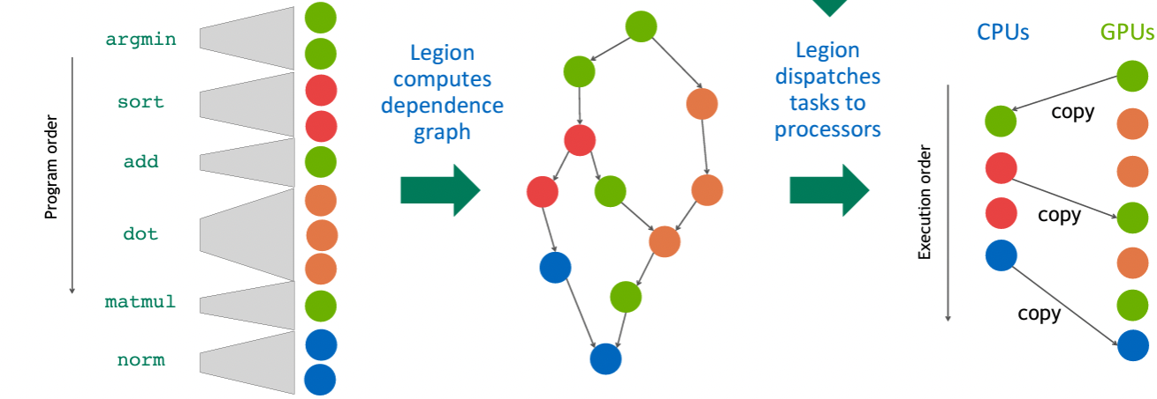
Legion Runtime [1]
Task-based implicit system: task = unit of execution candidate for parallel/distributed execution
Data-centric: user only defines data (regions) and partitions
Task have privileges over regions → dependence analysis → task graph
GPU tasks have to be written manually (1 variant per processor kind)
Not supposed to be used directly in a scientific HPC code, but rather to write libraries in a “Bring your Own Abstraction” manner
Mapper
Credits: Wonchan Lee, Legion Retreat 2022 (https://theory.stanford.edu/~aiken/LegionRetreat22/videos/04-lee.mp4)
[1] Bauer, M., et al., SC’12, IEEE, 2012

Slide 3
Legion programming system
Regent [2]
(Legion language)
Sequential semantics, type system ensures program correctness
Lua/Terra metaprogramming
CPUs + GPUs (NV/AMD/INTEL)
Static optimizations
Pygion [3]
(Legion Python API)
OpenMP, no GPU
Dynamically type-checked
Optimizations partially supported
Can call external Python lib. (CuPy, Pytorch, …)
Cunumeric (Numpy drop-in replacement)
legate.sparse
(scipy.sparse drop-in replacement)
Legate [4]
Framework for building composable Legion libraries
Higher-level of abstraction (e.g. Legate Stores, Legate tasks, …)
Prof. Aiken (Stanford), Elliott Slaughter (SLAC), Sandia, LANL, …
Nvidia
High-level, compact
Legion [1] (C++ API)
(Implicit Task-based distributed computation)
Low-level, verbose
Realm
(Explicit Task-based distributed computation)
GASNet-EX
(Communication layer)
LBNL
[1] Bauer, M., et al., SC’12, IEEE, 2012
[2] Slaughter, E., et al., SC’15, IEEE, 2015
[3] Slaughter, E., et al., PAW-ATM, IEEE/ACM, 2019
[4] Bauer, M., Garland, M., SC’19, IEEE, 2019

Slide 4
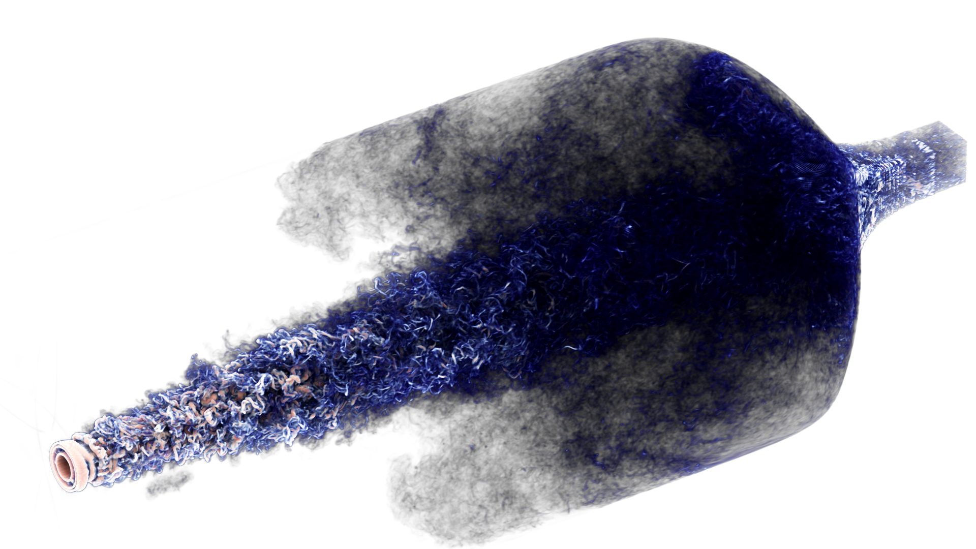
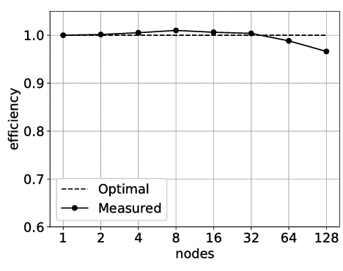
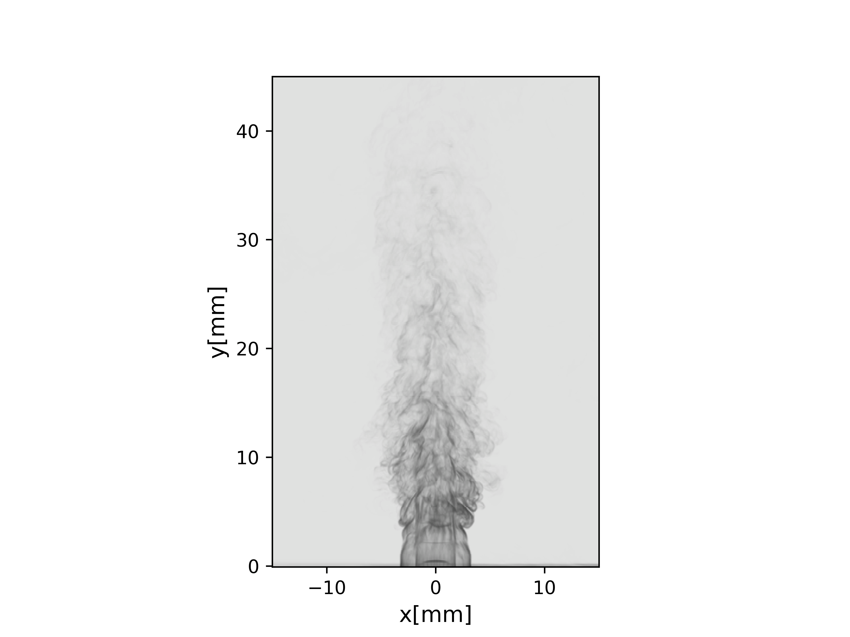
INSIEME core solver: HTR [1, 2]
Weak scaling on Lassen
Implementation: hybrid Legion C++ API/Regent, good weak scaling
Features: high-order finite difference, multi-species combustion, hypersonics, laser modelling, two-phase flows, multi-block complex geometries, etc…
Difficulties: not suitable for fast scripting, difficulty to execute hybrid workflows for UQ, or with embedded ML
[1] Di Renzo, M., Fu, L., Urzay, J., Computer Physics Communications, 2020
[2] Passiatore, D., et al., To be submitted, 2024

Slide 5
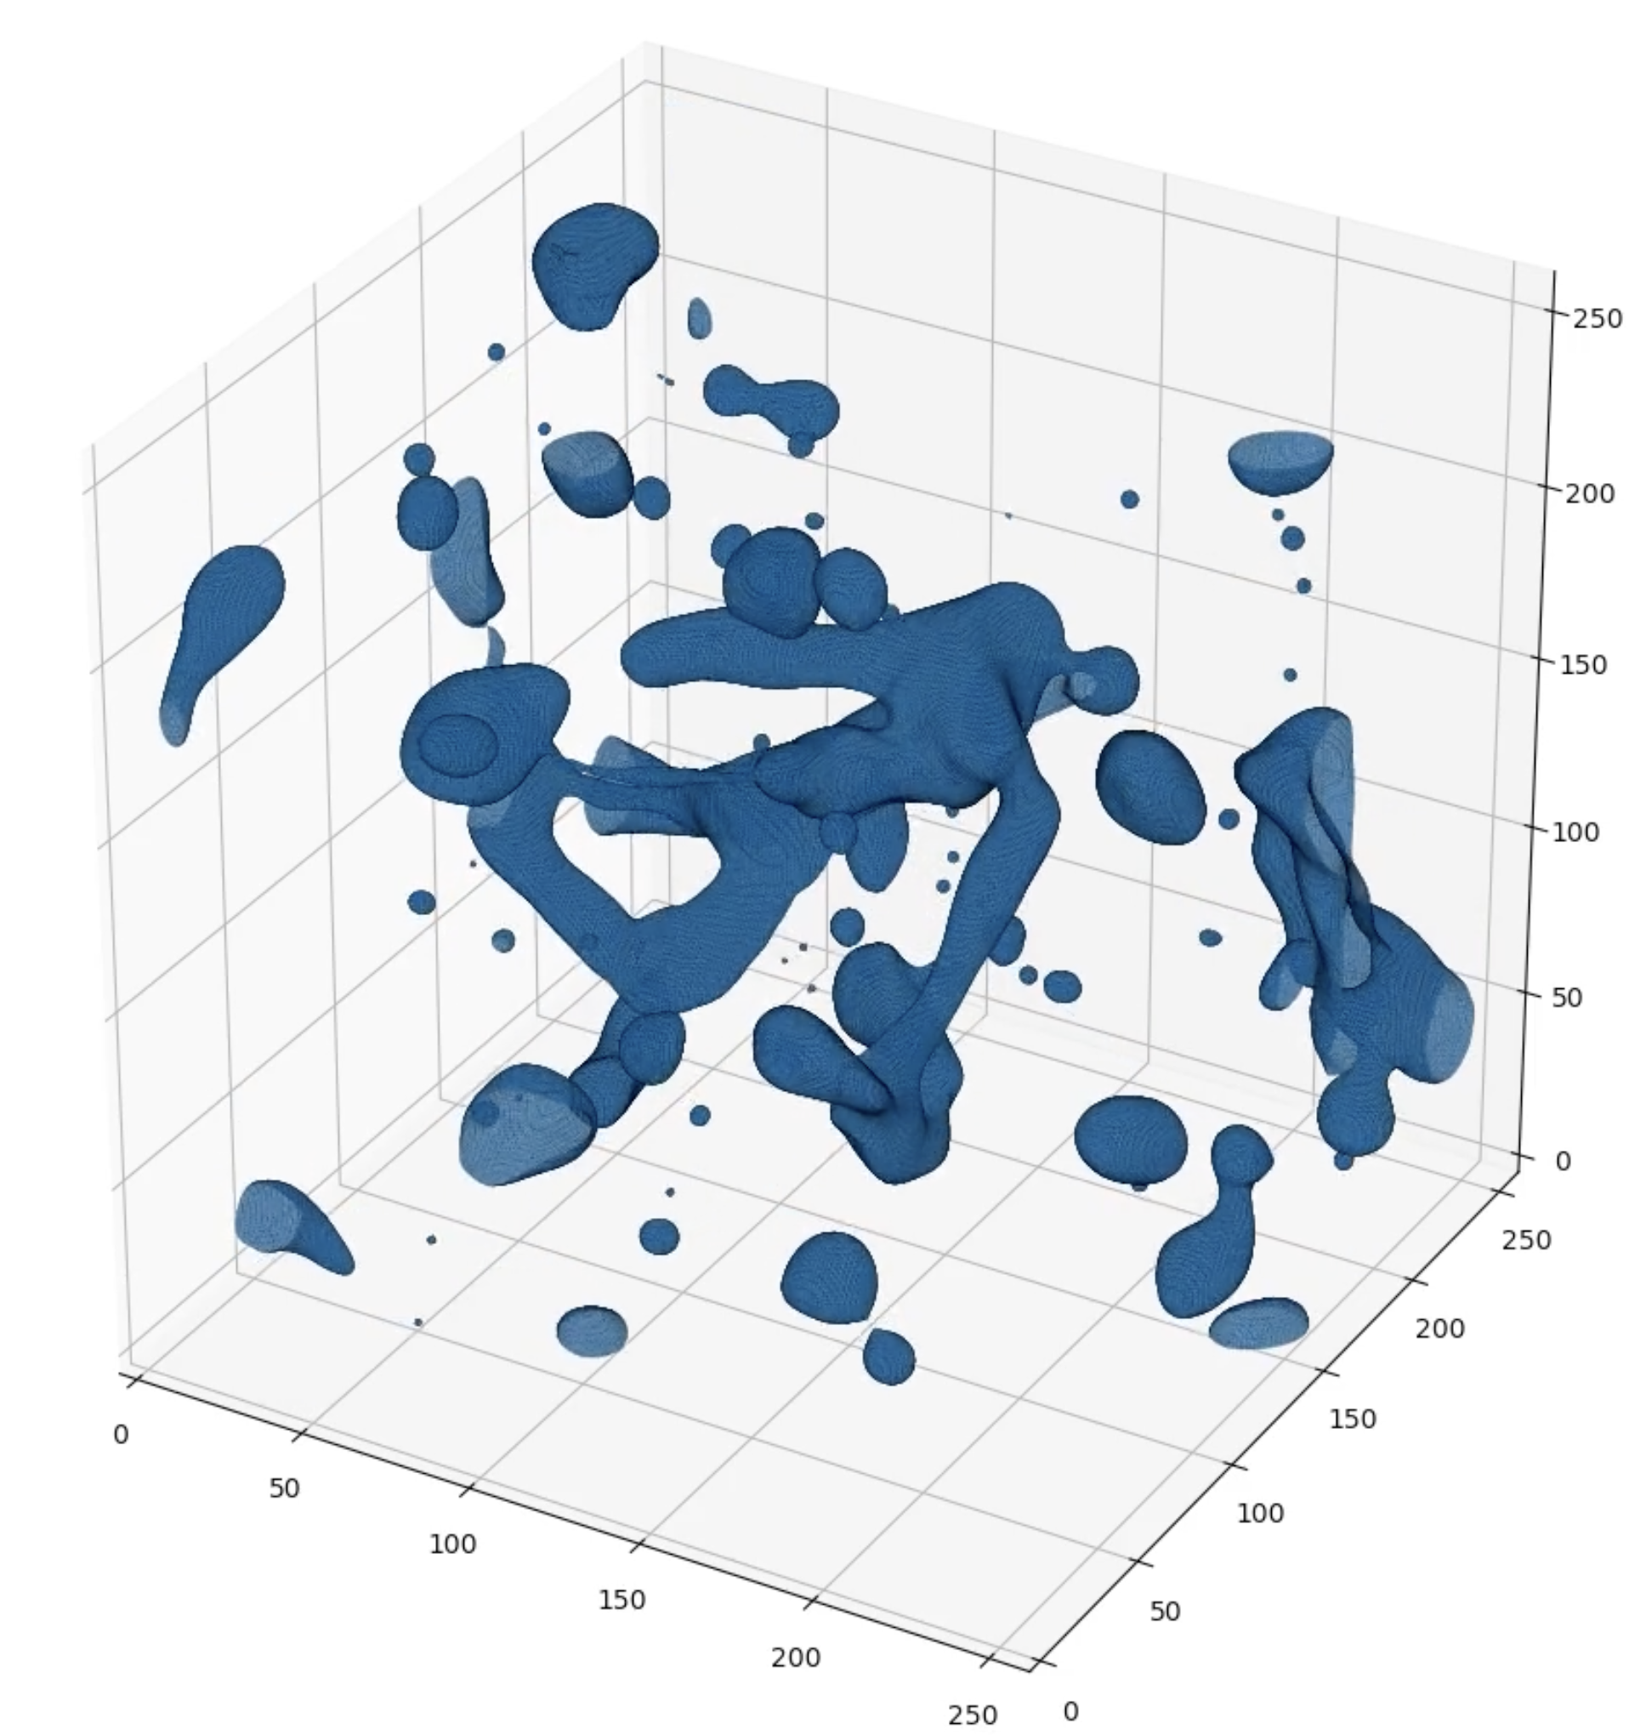
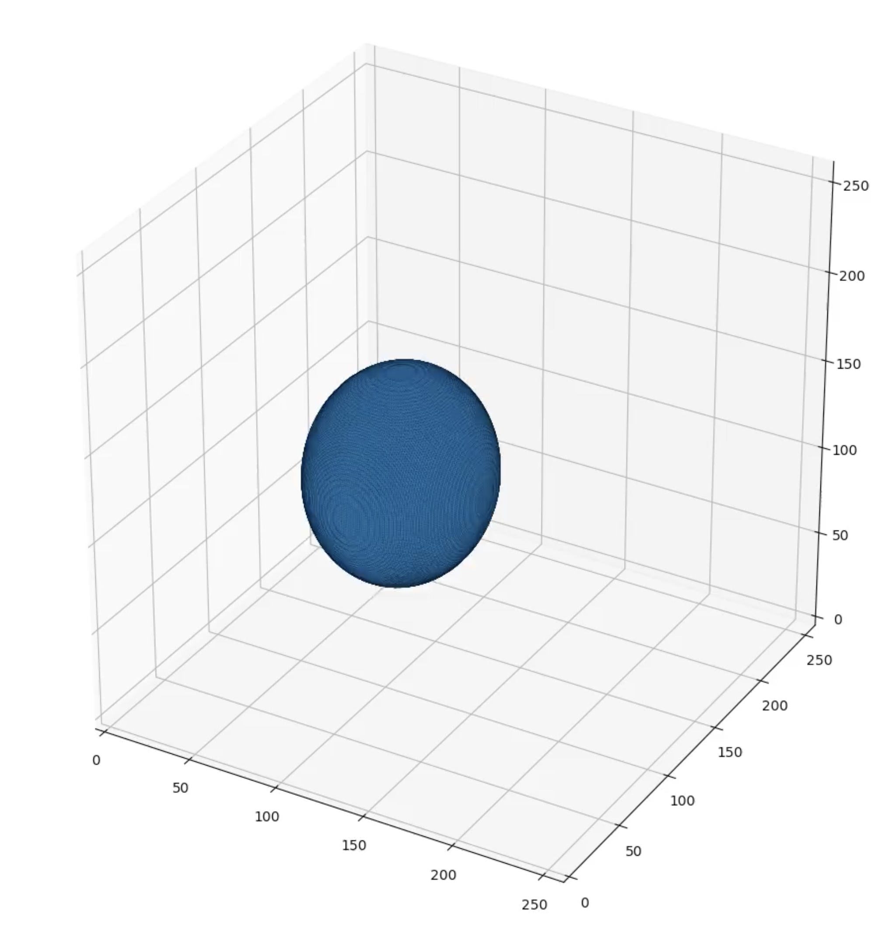
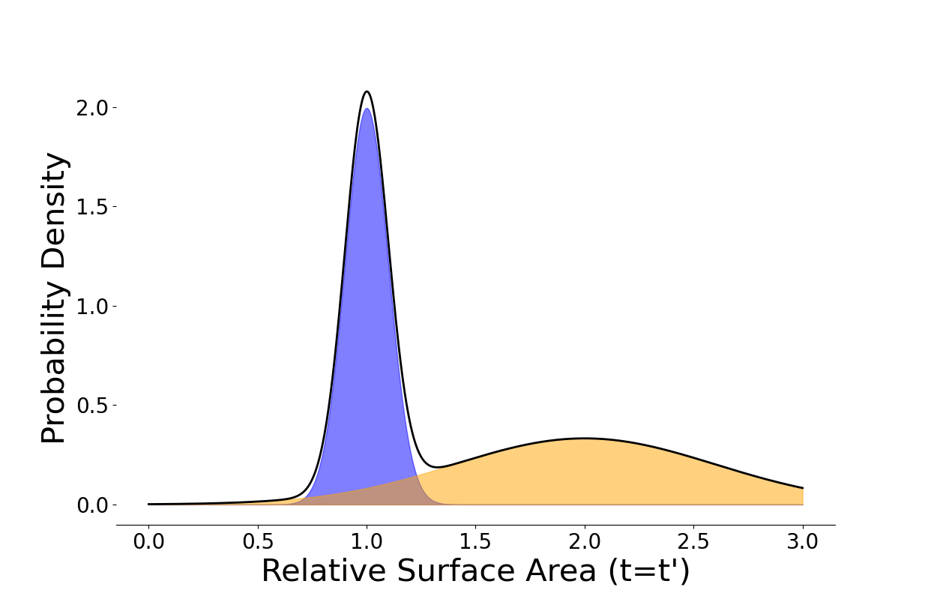
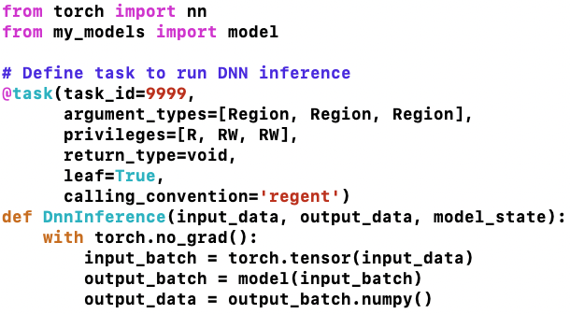
Hybrid CFD/ML: embedded ML surrogate with Pygion/Regent
Ground truth simulation: liquid droplets atomization → many grid points required
Embedded ML surrogate: droplets atomization replaced by an ML model (64M, 3D ResNet) → fewer grid points required
# of Drops
Drop Volume
main() in Regent, CFD tasks in Regent, ML model in Python (Python API) for fast scripting
Pygion can wrap the call to any Python package with a @task decorator

Slide 6
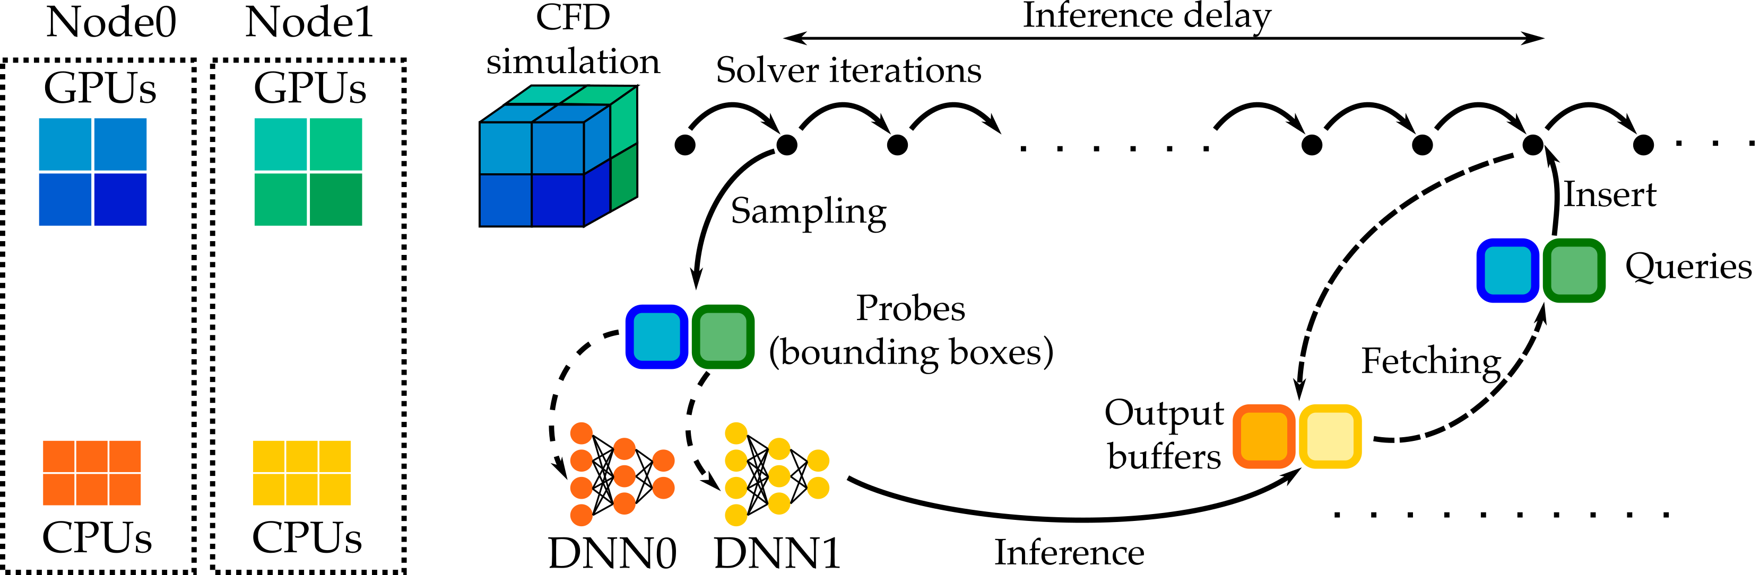
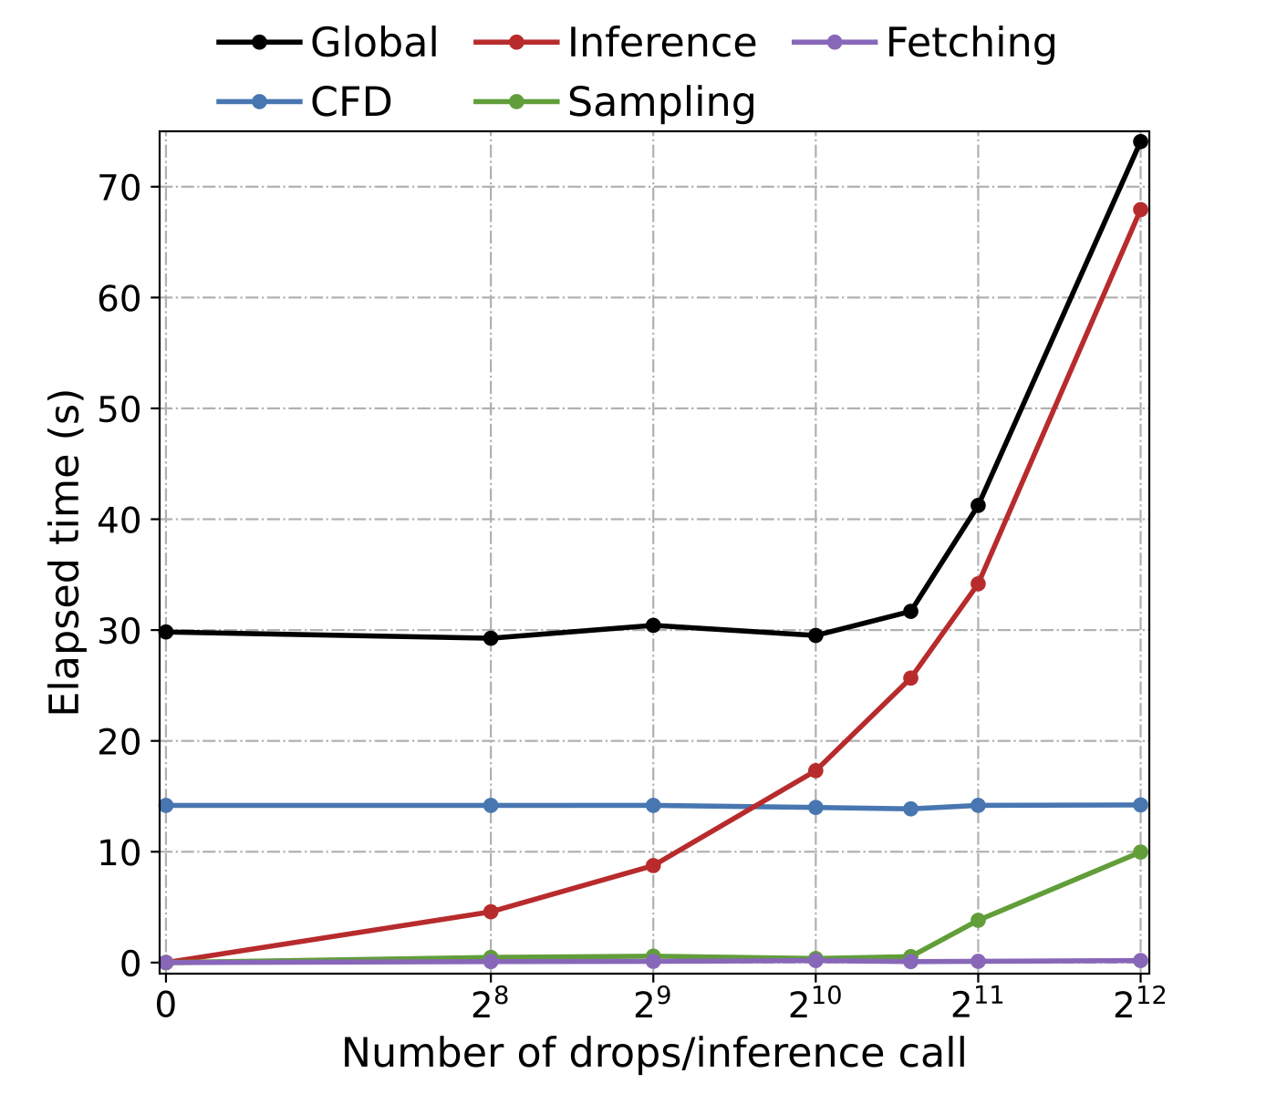
Hybrid CFD/ML: embedded ML surrogate with Pygion/Regent
DNN throughput scaling
Efficient use of heterogeneous architecture: CFD task (Regent) on GPUs + ML tasks (Pygion) on CPUs with OpenMP parallelism
Embedded ML surrogate → negligible overhead in comparison to a stand-alone CFD solver

Slide 7
Another hybrid workflow: online active learning [1, 2]
Ensemble of CFD simulations executed on GPUs (Regent)
Ensemble of DNN trained on the CPUs using Pytorch API calls wrapped in Pygion tasks
Feedback from partially trained DNN used to schedule next set of simulations
[1] Laurent, C., Maeda, K., CTR Annual Research Briefs, Stanford, 2022
[2] Laurent, C., Maeda, K., APS, 2022

Slide 8
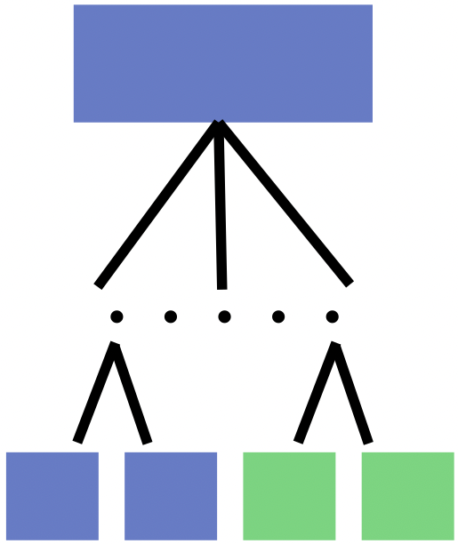
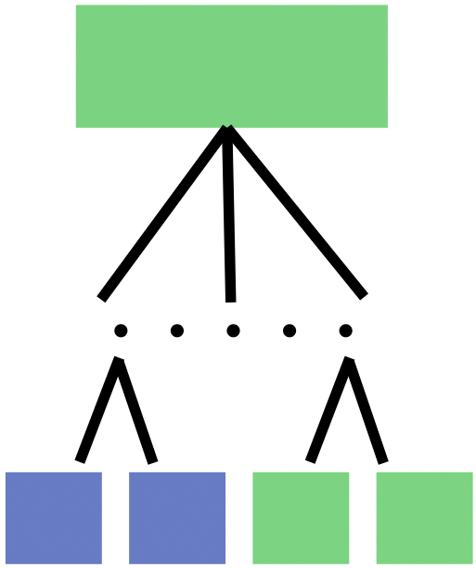
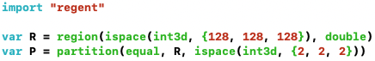
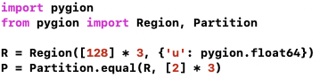
Writing parallel and distributed hybrid apps with Regent/Pygion
Two flavors: Regent top-level vs. Pygion top-level
Regent
Pygion
main()
main()
Python GIL: no multi-processing/subprocesses in Pygion → no automatic parallelization and tasks run on a single node/core
But Pygion tasks can launch Regent subtasks targeting GPUs/OpenMP procs
Pygion top-level task can also launch subtasks wrapping Pytorch, CuPy, etc…
Compute kernels
Python external libraries
Compute kernels
Python external libraries
Create data (region) and partition it: Regent and Pygion share the same powerful partitioning operators

Slide 9
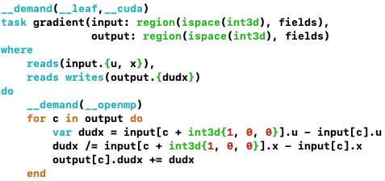
Writing parallel and distributed hybrid apps with Regent/Pygion
Write compute kernels and call to external Python libraries (leaf tasks)
Regent task for gradient computation
Pygion task wrapping a Pytorch call for DNN inference
LLVM backends → __demand(__cuda) compiles task to NVPTX/AMDGPU/SPIR-V
Many automatic optimizations at compile time (e.g. ”leaf” not required)
Lua metaprogramming can be used to implement task-factories and code generators
Pygion: dynamic type-checking
Some optimizations and dynamic and automatic, some have to be added in the task decorator (e.g. “leaf”)
Uses Pytorch OpenMP parallelism

Slide 10
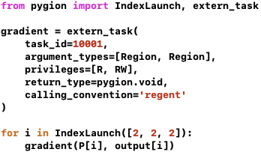
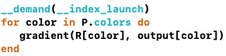
Writing parallel and distributed hybrid apps with Regent/Pygion
Write compute kernels and call to external Python libraries (leaf tasks)
Regent task for gradient computation
Import Regent compute kernel
Launch the task to multiple nodes/cores

Slide 11
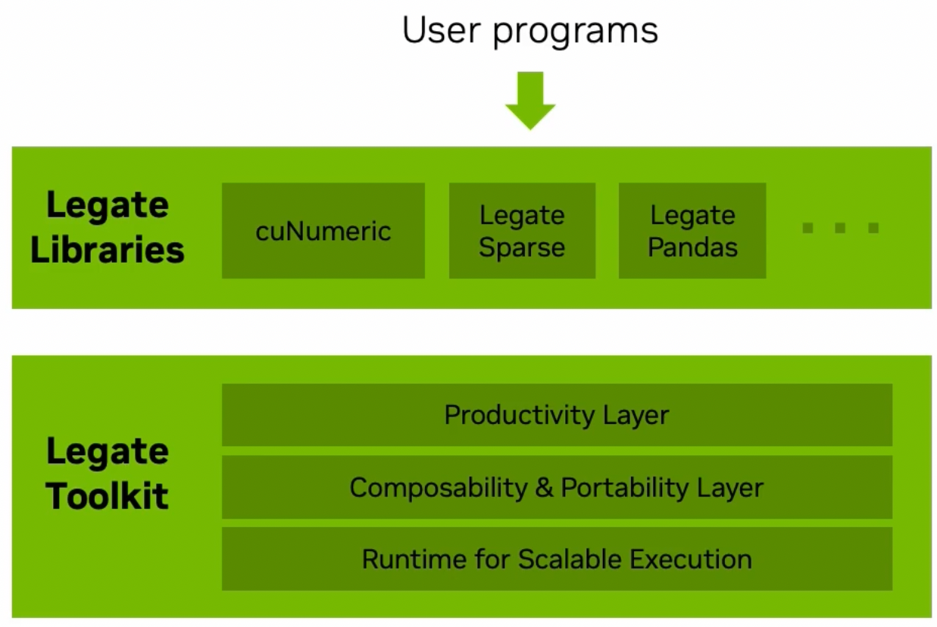
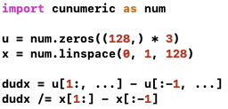
Legate and CUnumeric
Designed as a framework with higher-level of abstractions for writing composable Legion libraries (parallel/distributed)
Abstractions for composability: data containers (e.g. Numpy array, scipy CSR matrix) backed by Legate Stores (mapped to region field in Legion)
Example: Cunumeric (Numpy drop-in replacement), legate.sparse (scipy.sparse drop-in replacement), legate.pandas (pands drop-in replacement)
White-box approach: Legate developers write all APIs from scratch rather than reusing existing implementation
Gradient computation in Cunumeric
Credits: Wonchan Lee, Nvidia GTC 2023
(https://www.nvidia.com/en-us/on-demand/session/gtcspring23-s51789/)
More in the hands-on demo…

Slide 12





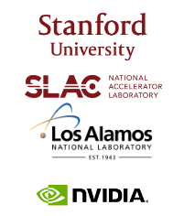
Acknowledgements and funding
Legion applications
https://github.com/stanfordhpccenter/HTR-solver
Legion Runtime and language
https://github.com/StanfordLegion/legion
https://legion.stanford.edu/
Legate
https://github.com/nv-legate/legate.core https://github.com/nv-legate/cunumeric
https://nv-legate.github.io/cunumeric/23.11/
Questions?

